Slide 1
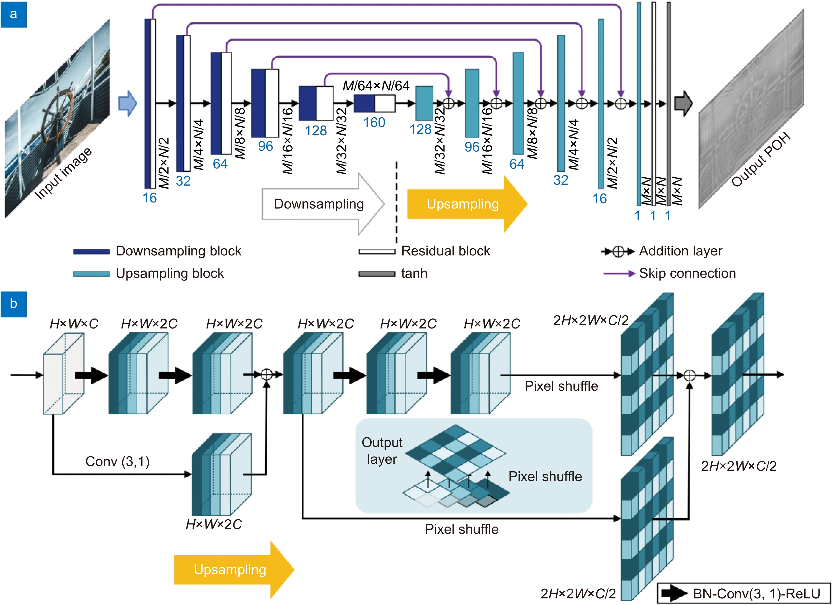
Figure 3. (a) U-Net neural network architecture of 4K-DMDNet. (b) Upsampling block architecture. The figures between the brackets present the kernel size and the stride of the convolutional layer, respectively.
Kexuan Liu,Jiachen Wu,Zehao He,Liangcai Cao
4K-DMDNet: diffraction model-driven network for 4K computer-generated holography
https://doi.org/10.29026/oea.2023.220135

